Slide 1
Dude, Where’s My Beer?
Allison | Emma | Igor | Erika | Surin

Slide 2
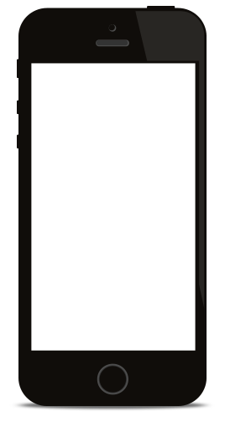
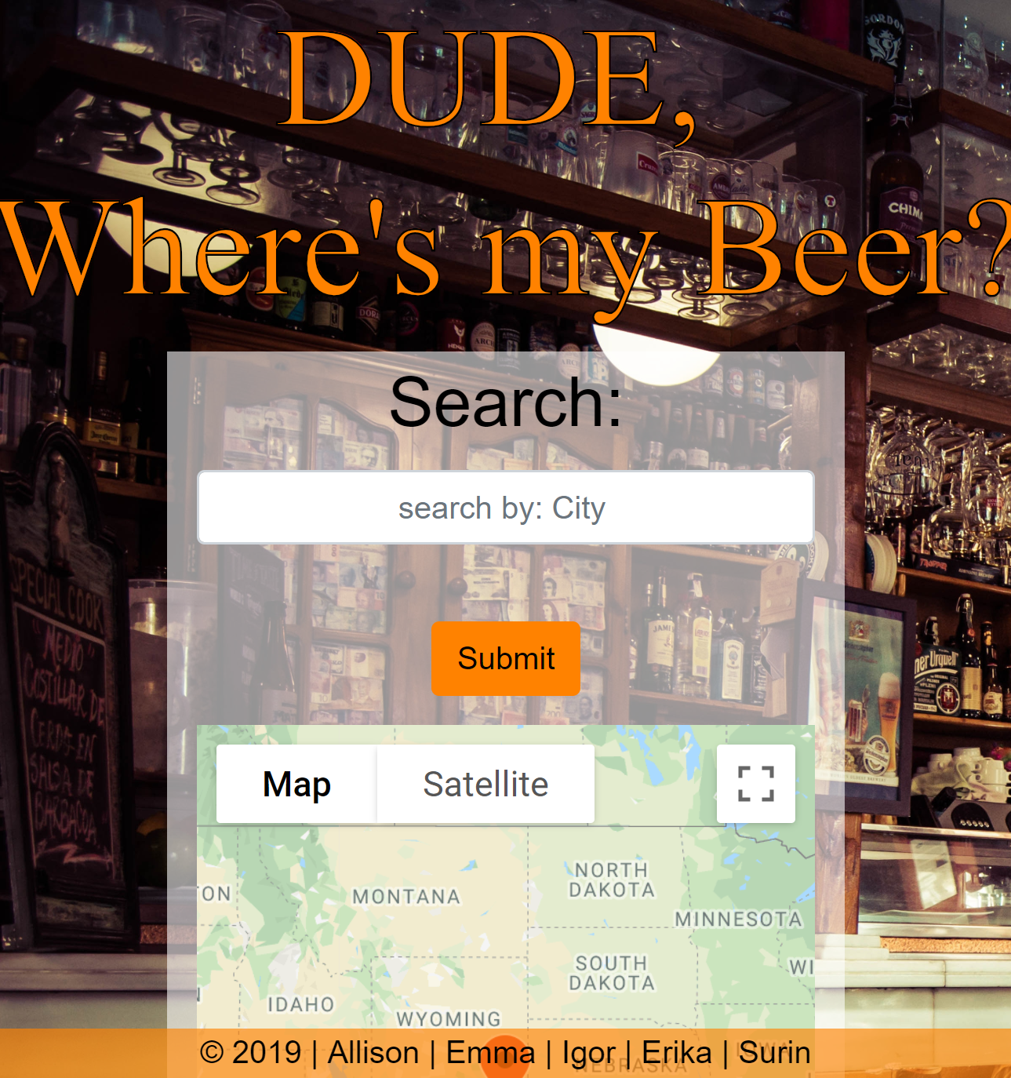
Product Description
Dude, Where’s my Beer?
Is an app created to help you and your friends find the nearest and best beer establishment. Using a locational search a user will be able to find all of the establishments that serve beer near them and then filter by rating to ensure they are getting the best brew.

Slide 3
Product Goal
Dude, Where is My Beer? Is:
Convenient and user friendly
Community building
The best way to find the highest rated beer
Problem that the product will address:
Gives users with lack of knowledge of nearby area a chance to find their new favorite brew-pub.

Slide 4
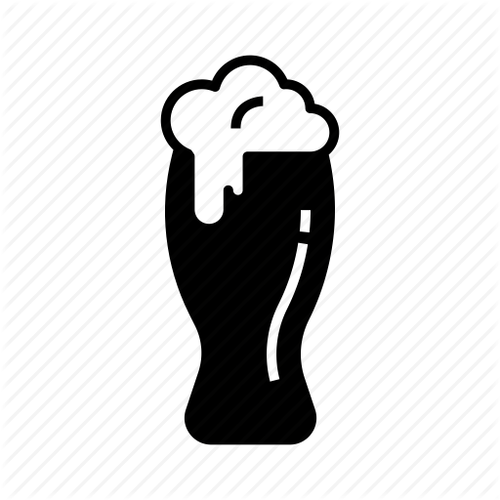


Target Audience
Beer Enthusiasts
Those who love beer and are constantly looking to find the next best brewery in Denver.
Tourists
Those who who are visiting Denver and want to experience the city through trying to brew-pubs.
New Denver Residences & City Adventurers
Those who love to discover new parts of their city through trying new brew-pubs.

Slide 5
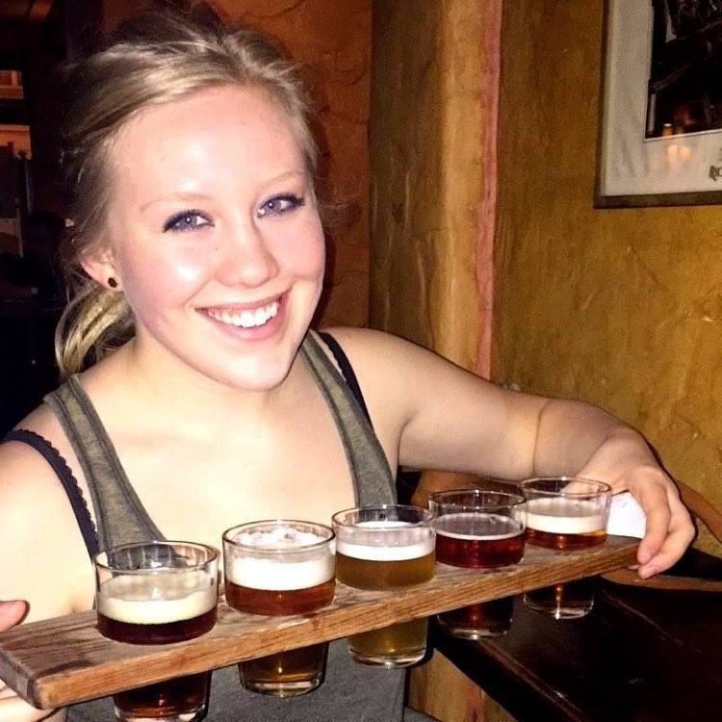
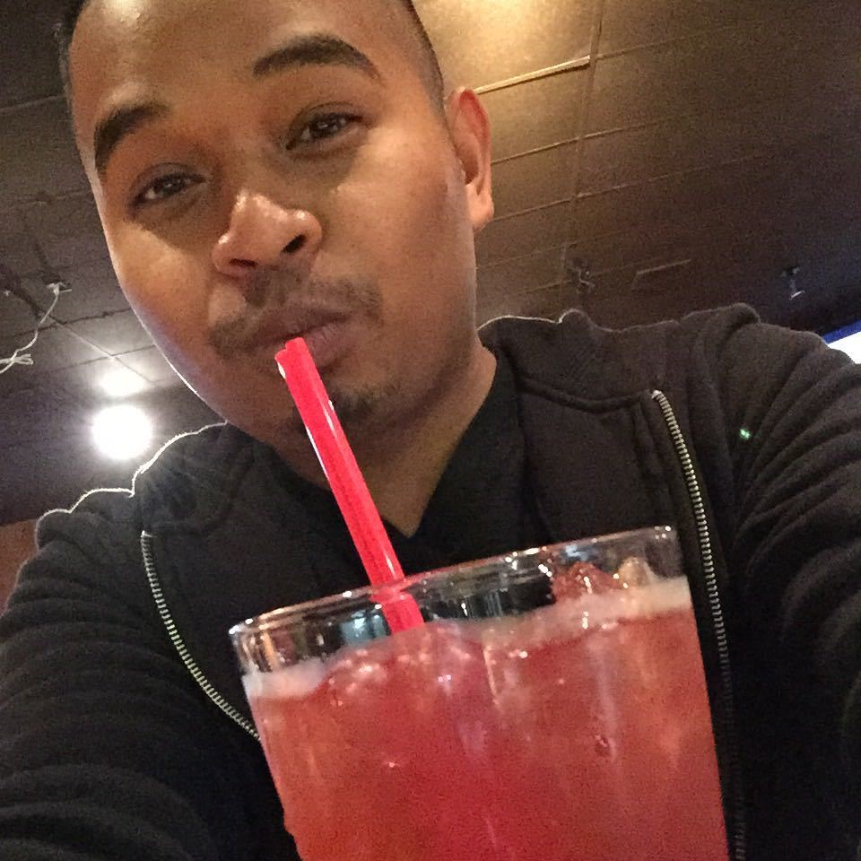
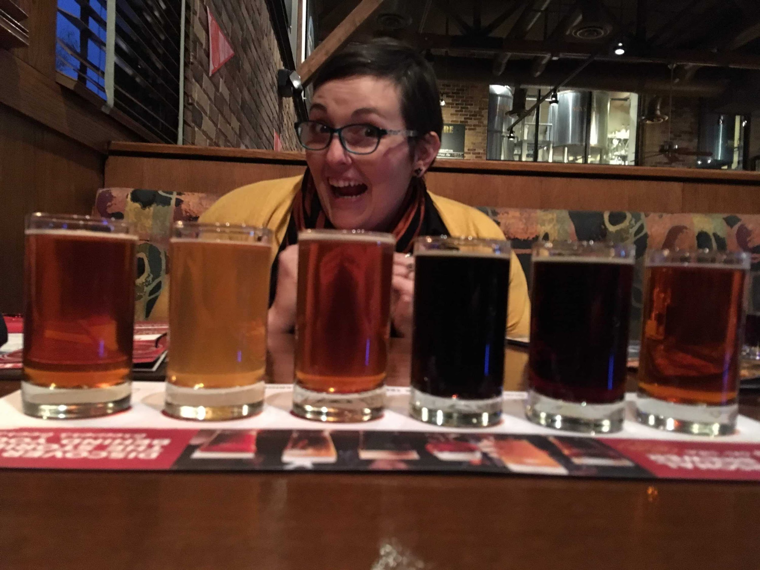
User Stories
Surin
Surin is a beer lover looking for the next best brewery in Denver. He prides himself on knowing all the best spots in Denver and uses the rating feature in Dude, Where’s My Beer? to find them.
Erika
Erika is a tourist visiting Denver for the first time and wants to find a nice place to find a beer close to her Air BnB. Unfamiliar with the area she looks to Dude, Where’s My Beer? search function to find the best spot close to her.
Emma
Emma is a city adventurer that loves to explore the next up and coming neighborhood in Denver through Dude, Where’s My Beer? map feature.

Slide 6
Technologies Utilized
APIs:
Zomato API
Google Maps API
Bootstrap API
CSS
JavaScript
Languages Utilized:
HTML
CSS
JavaScript
jQuery
Check it out: https://ebayler.github.io/Team7/

